Slide 1

Rewards & Sanctions - Review
What did school council think?
Pleased at more money being invested in rewards
Want a range of vouchers instead of just WHS
Prom ticket idea well received
Agreed with new DT system
Like the idea that students know what could happen next and that they would be warned before further action
Very much against whole class sanctions and think new system helps prevent this, focussing on individuals.

Slide 2
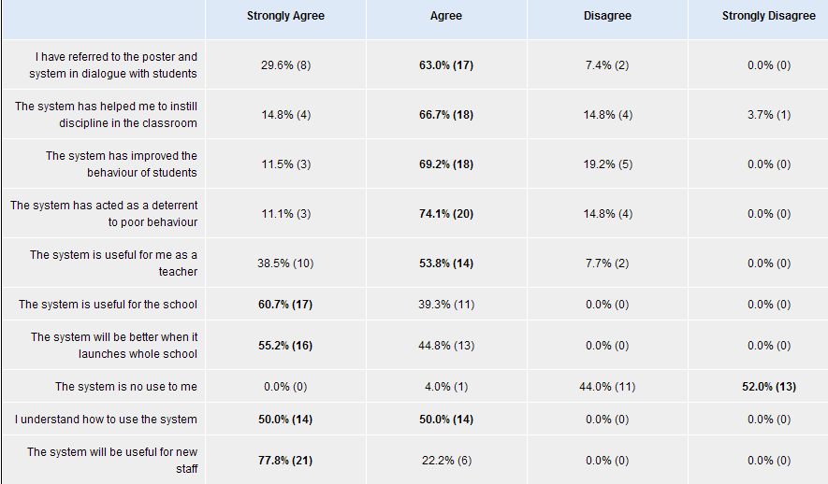
Rewards & Sanctions - Review
What did staff think?

Slide 3
Rewards & Sanctions - Review
What Now?
The system launches for the whole school immediately
Letters have gone home to parents
Assemblies will take place to explain to students this week
Use it straight away BUT be aware that students may not know fully until the latter part of the week.

Slide 4
Rewards & Sanctions - Review
Recap - How does it work?
Dialogue on poster to be used with students.
Positive rewards actioned
Sanctions system actioned
System to be consistently used by all staff leading to students understanding where they stand and knowing what to expect.

Slide 5
Rewards & Sanctions - Review
Positive Rewards?
Praise & Encouragement
Credits – ALL YEAR GROUPS – leading to new rewards prizes
Letters home where appropriate
Department policies as required
End of year trip – to be arranged by Learning Manager
 | Years 7-10 | Year 11
50 Credits | Holy Trinity USB Memory Stick
100 Credits | £5 Voucher | £5 voucher OR £5 off Prom Ticket
150 Credits | £10 Voucher | £10 voucher OR £10 off Prom ticket
200 Credits | £15 voucher | £15 voucher OR £15 off Prom ticket

Slide 6
Rewards & Sanctions - Review
Sanctions System?
Use your pad – one form for all DTs
Procedure –
Verbal warning
Loss of behaviour star (may also move seat/remove temp)
Issue DT1 – Subject staff
Carry out DT1
If attends start a fresh next time
If not give another chance without issuing a new form
If ‘no show’ again then refer to HOD for DT2
Auto system then picks up attendance
If major incident or LM/SLT feels necessary they may issue DT3/DT4

Slide 7
Rewards & Sanctions - Review
Trail main issues/comments?
Admin role is vital – get forms to office ASAP
Students have a right to the verbal & written warning first
DT1s must be in school time
Only Subject Leaders can issue DT2s
Only Learning Managers can issue DT3s
Only Senior Leaders can issue DT4s
Leadership pick ups not fair so staff to record students sent out on uniform card.
Staff running DT are on rota displayed in staff room, they should collect/return the relevant blue box from reception
Students may turn up earlier than staff!
Incident forms remain for serious incidents
Consistency from all staff is key!

